Slide 1
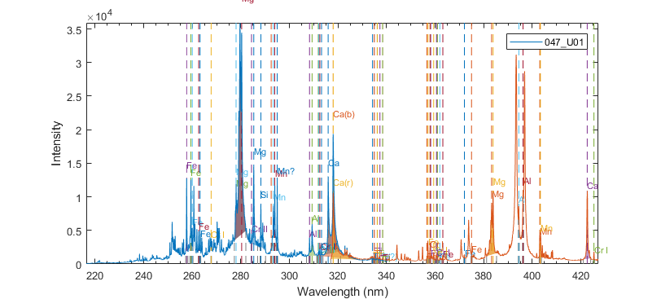

Slide 2
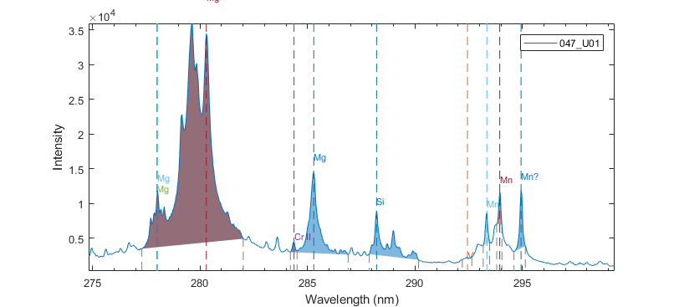

Slide 3
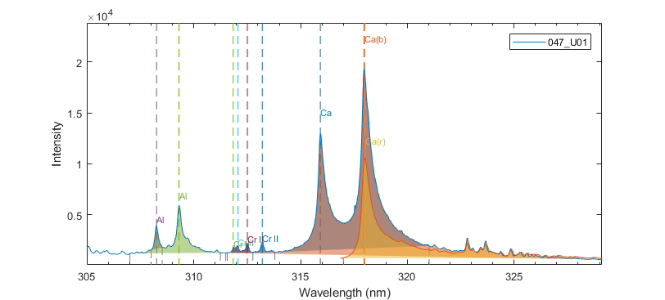

Slide 4
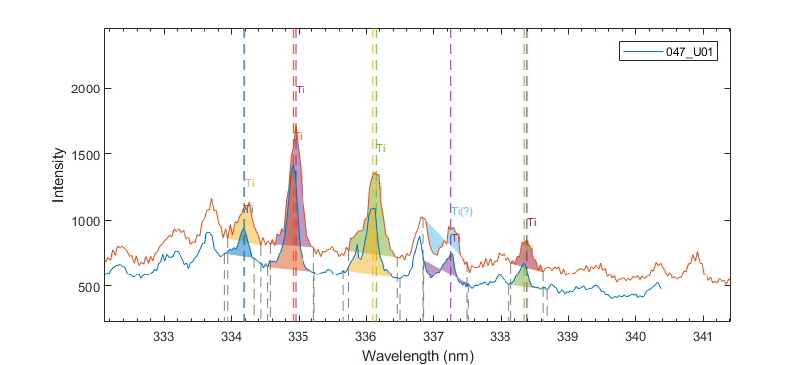

Slide 5
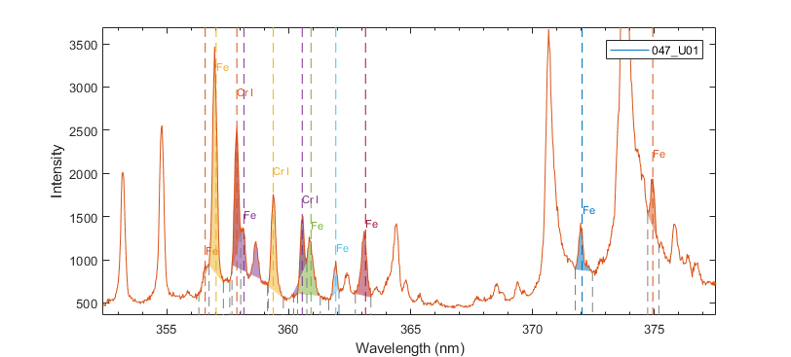

Slide 6
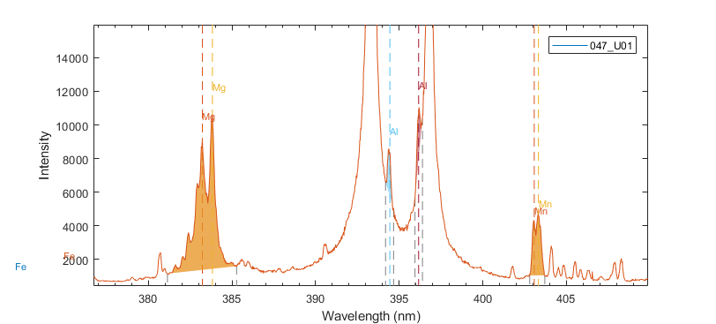

Slide 7
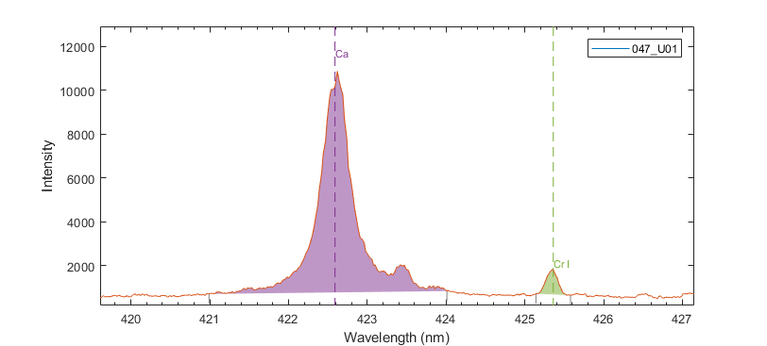

Slide 8
Si/Ca – 0.22xFe/Ca

Slide 9
Fe/Ca (361.9nm/318nm)

Slide 10
Mg/Ca – 0.73xCr/Ca

Slide 11
Al/Ca – 0.49XFe/Ca
Beror mer troligt på baslinje än faktisk interferens…?

Slide 12
Al/Ca (394.4/318)

Slide 13
V/Ca

Slide 14
Ti/Ca – 0.07xFe/Ca

Slide 15
Mn/Ca – 0.18xMg/Ca

Slide 16
Cr/Ca – 0.44xFe/Ca

